Slide 1
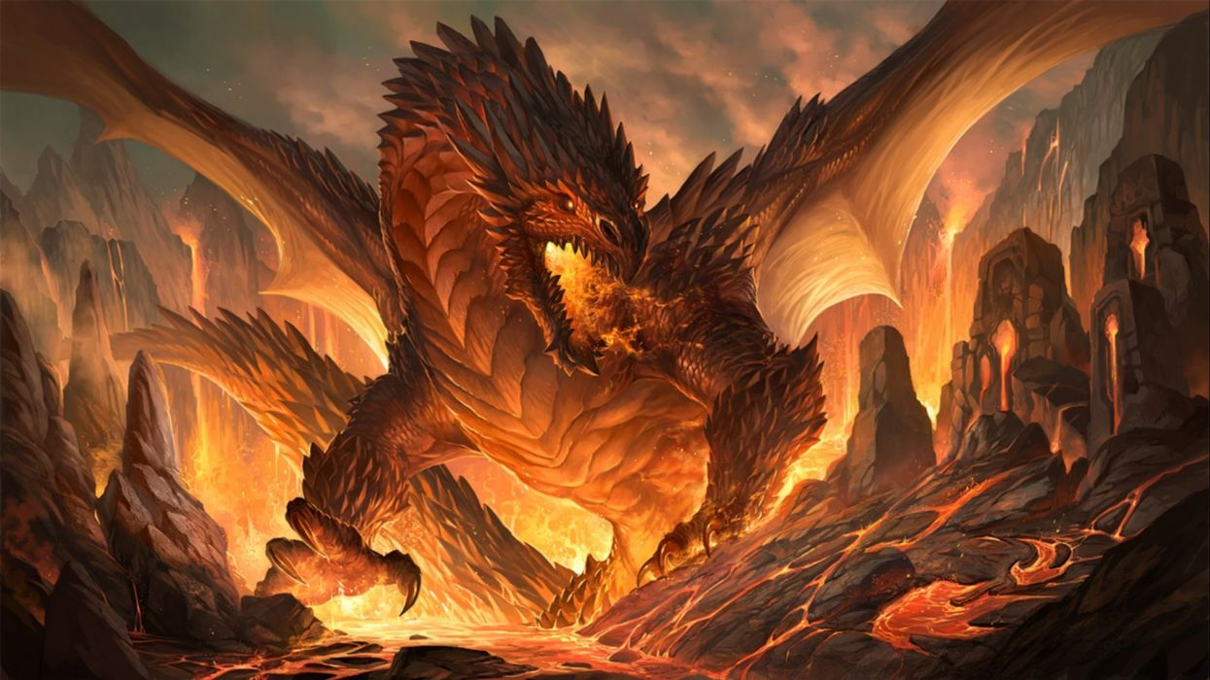
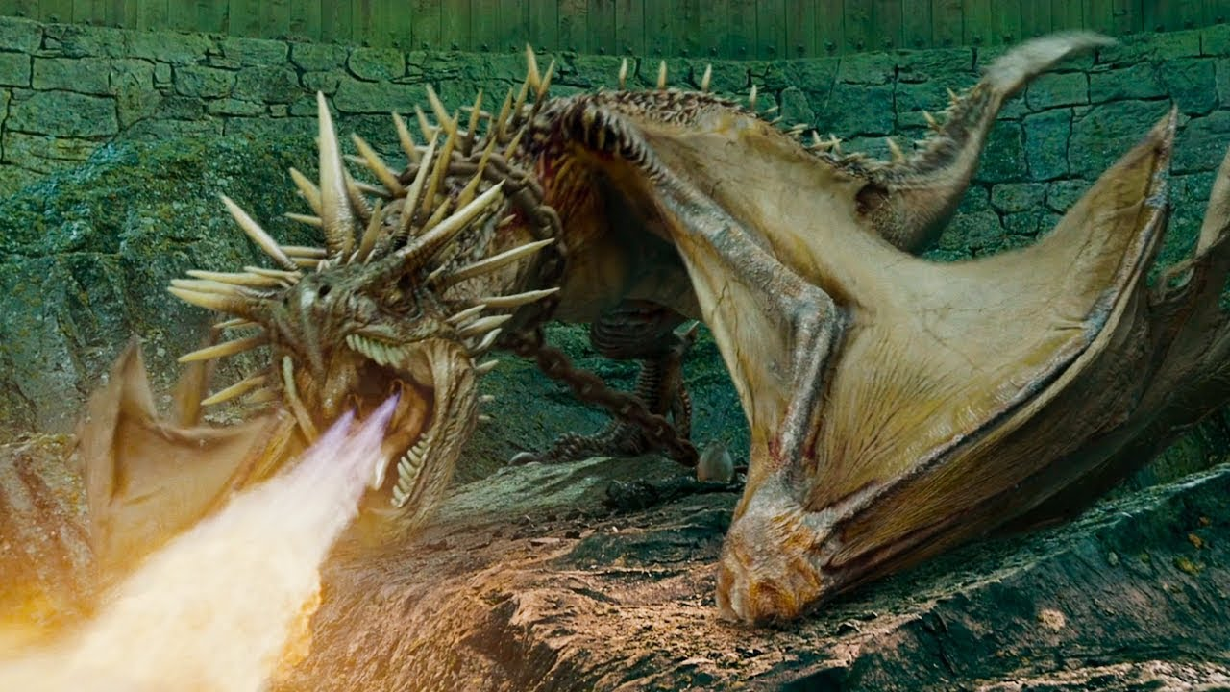
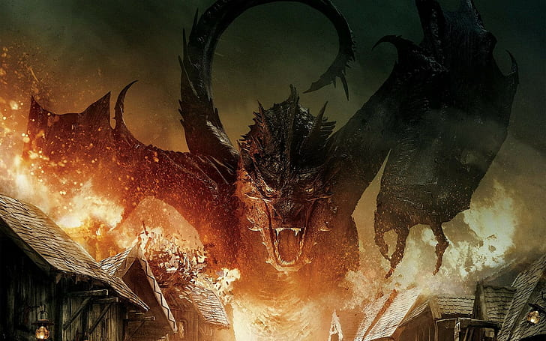
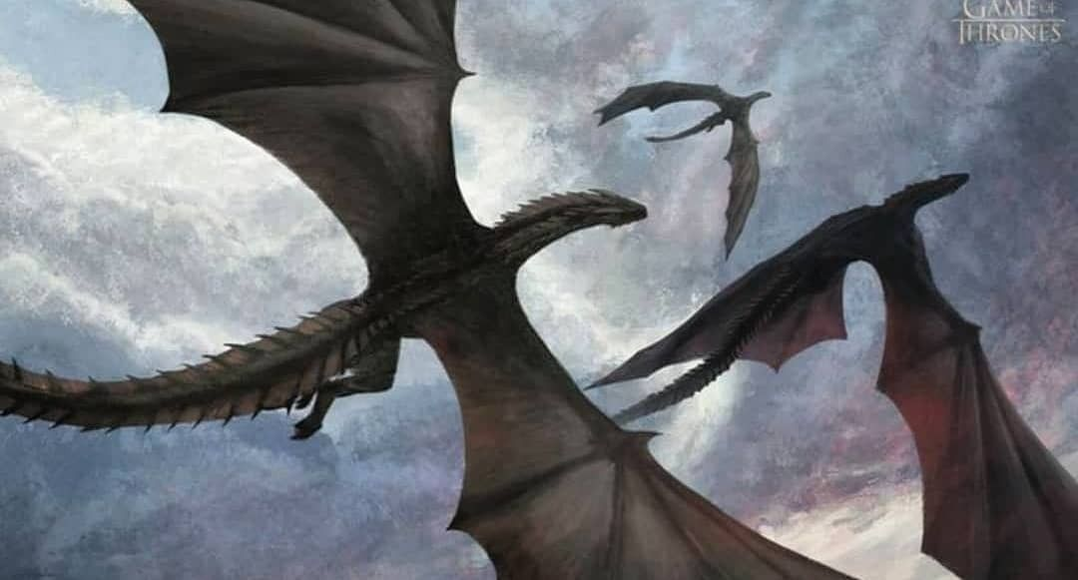

Slide 2
Dragons
The emergence and the diversity

Slide 3
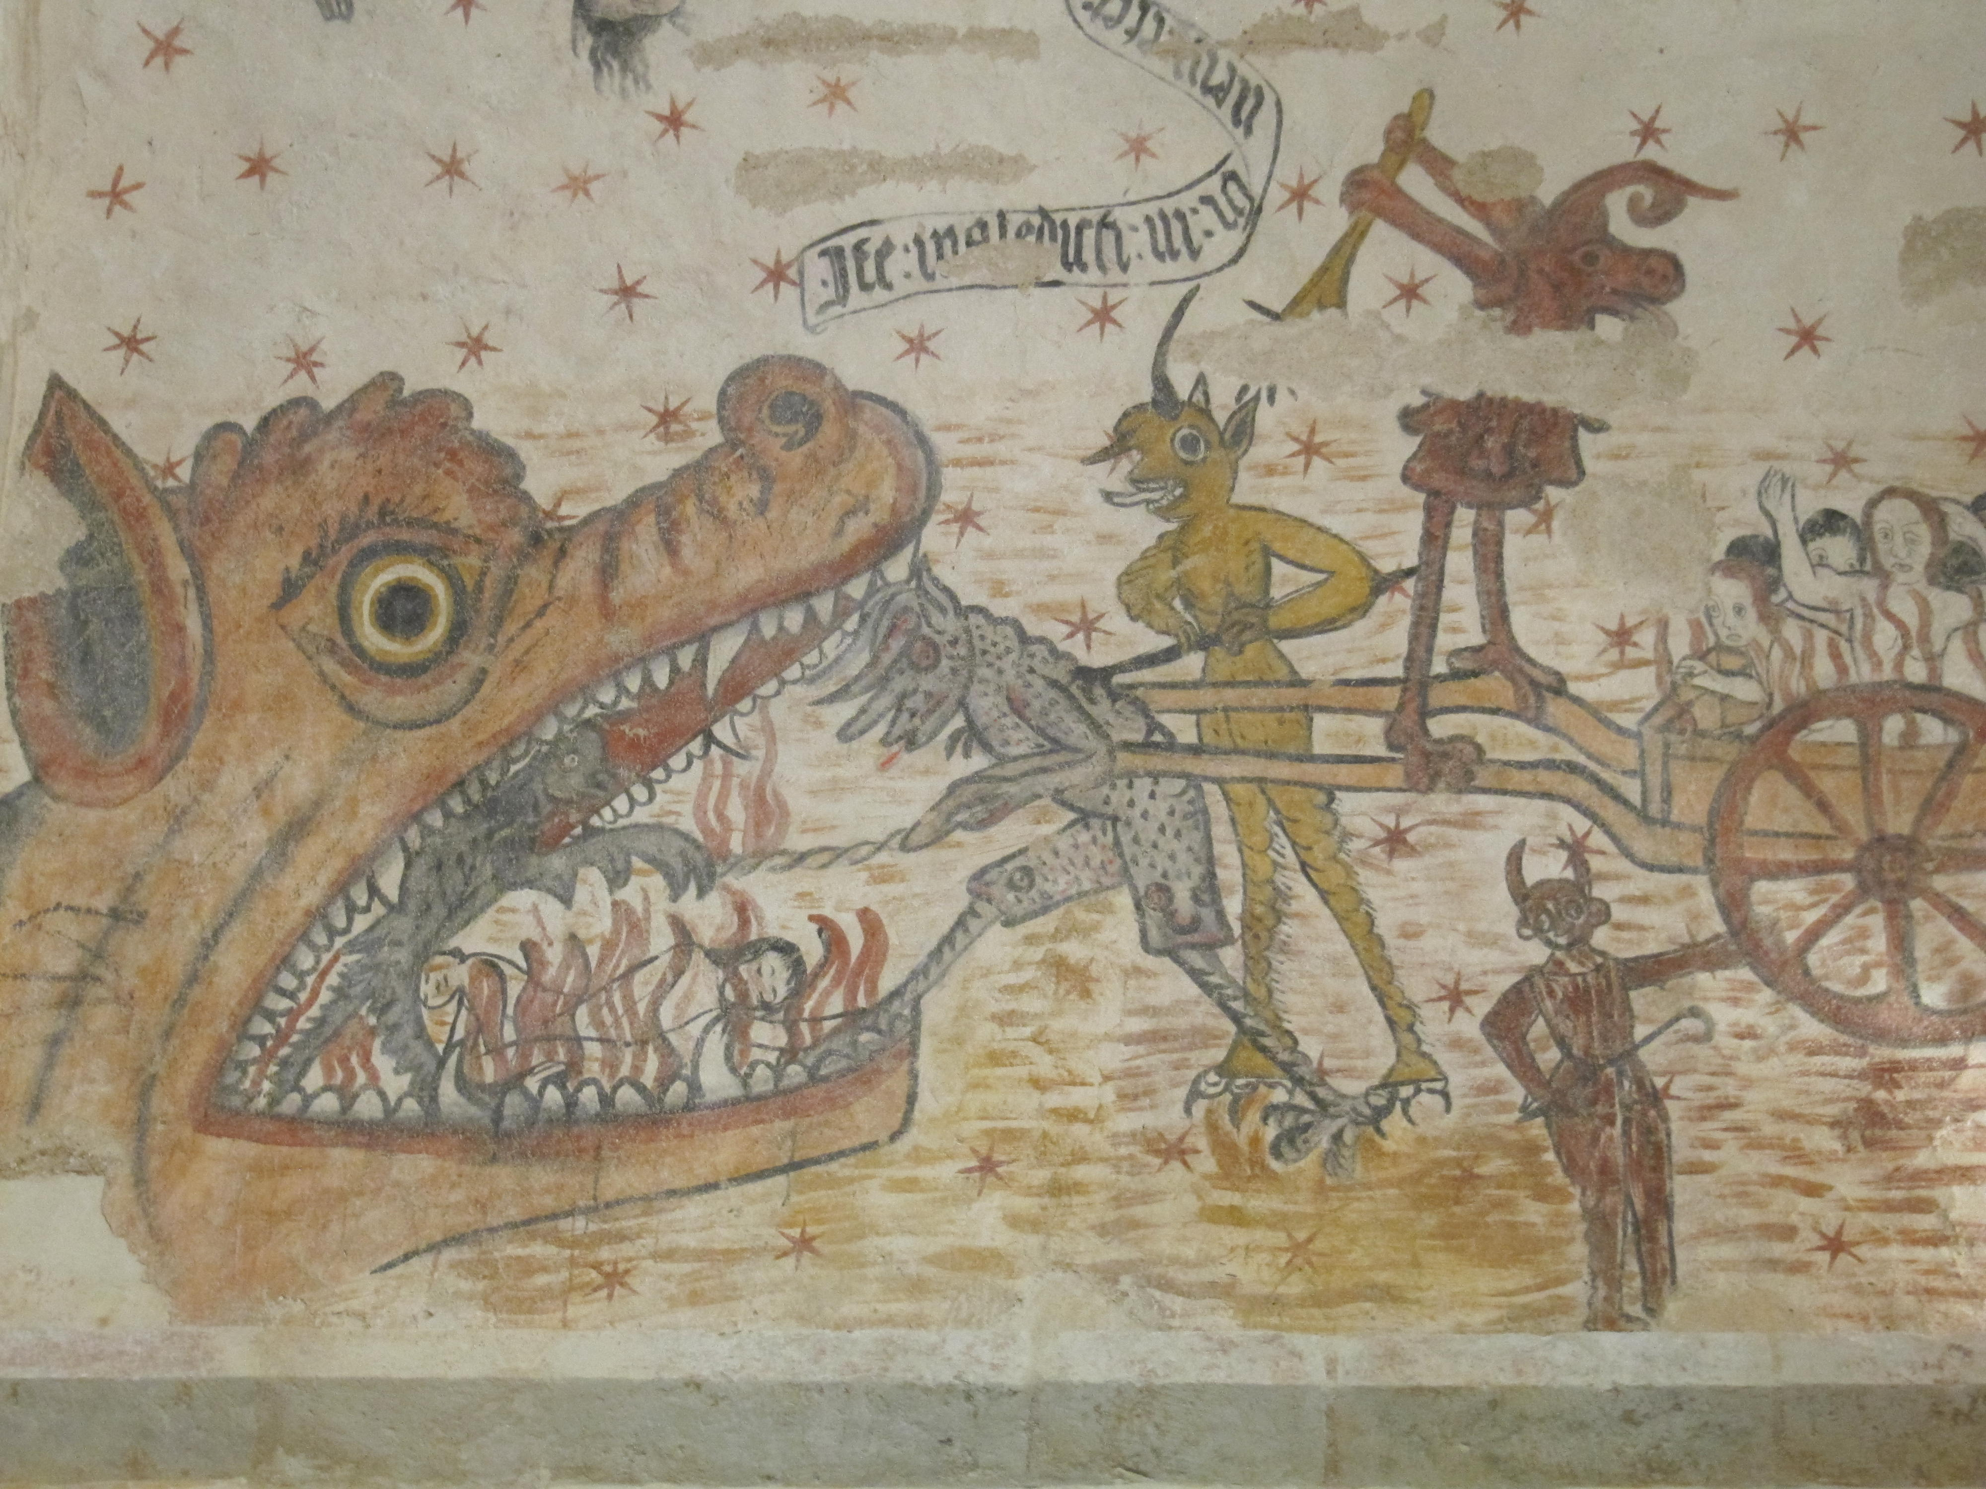
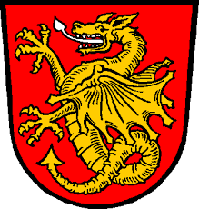
1. The dragon in Europe
General
Best known dragons in Europe and America
Mighty Enemy and beast
Often four legs, long snake neck, reptilian head, fire breath
Represents biggest fear -> in Christianity the hell itself
Often used in heraldic
Origin
Caves
Volcanoes
Snakes

Slide 4
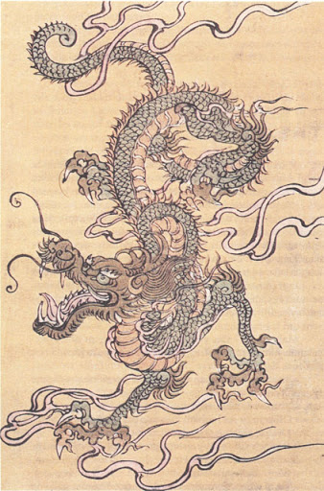
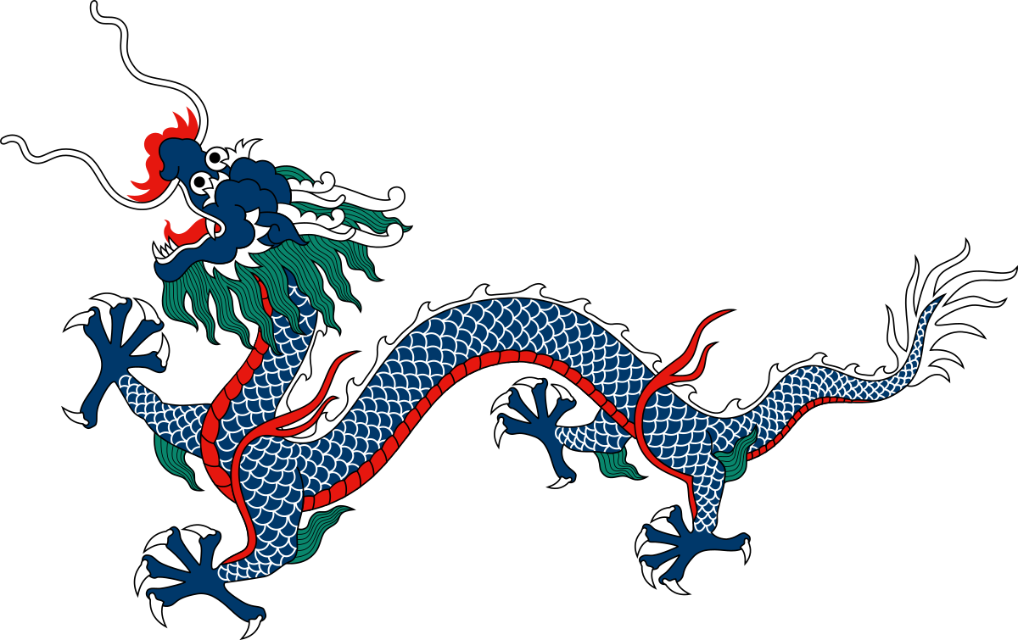
2. Long
General
snakelike body, with reptilian legs, but without wings, often grinning face with beart
Ancestor of mankind and lord of water
Important in chinese culture
Origin
Snake
Illustriation of a Chinese scholar

Slide 5
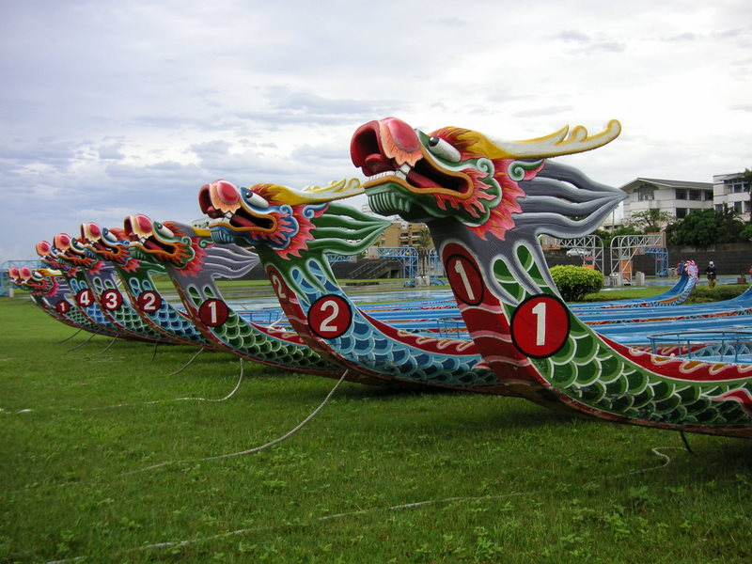

Slide 6
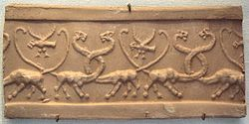
3. First Dragons
First mention: 450 B. C. by Herodot -> Mixed dinosaur bones were held for dragon bones by mistake
First illustration: 3500 B. C. in Uruk -> panther body, snake neck & head

Slide 7
Sources
https://www.sueddeutsche.de/wissen/frage-der-woche-woher-stammen-die-drachen-1.571873
https://www.youtube.com/watch?v=j4FIRN08wHc
https://de.wikipedia.org/wiki/Long_(Mythologie)
https://www.planet-wissen.de/kultur/fabelwesen/drachen/pwiederchinesischedrache100.html
https://www.smithsonianmag.com/science-nature/where-did-dragons-come-from-23969126/

Slide 8
Image sources
https://www.pinterest.co.uk/pin/753649318873846351/
https://www.wallpaperflare.com/the-hobbit-smaug-the-hobbit-the-desolation-of-smaug-movies-wallpaper-uymcd
https://www.youtube.com/watch?v=f2s-FDIcFH0
https://www.wallpaperup.com/650287/dragon_fantasy_artwork_art_dragons.html
https://commons.wikimedia.org/wiki/File:The_Mouth_of_Hell.JPG
https://de.wikipedia.org/wiki/Wappen_des_Marktes_Wartenberg
https://www.pinterest.de/pin/285274957617972946/
https://de.wikipedia.org/wiki/Drachenboot
https://de.wikipedia.org/wiki/Drache_(Mythologie)#Vorderer_Orient
https://www.pinterest.de/pin/332703491192887201/

